Slide 1
Ch 11. Propagating analyzing, and reducing uncertainty
Amy Hurford
Memorial University

Slide 2
Sensitivity analysis
How the change in a parameter, translates into a change in a quantity, i.e., an eigenvalue, an equilibrium, a variable at time, T.
Sensitivities are slopes
Elasticities standardize by the mean of the variable.
Dietz 2017. Ecological forecasting.

Slide 3
Variables and parameters

Slide 4
Sensitivity

Slide 5
Sensitivity

Slide 6
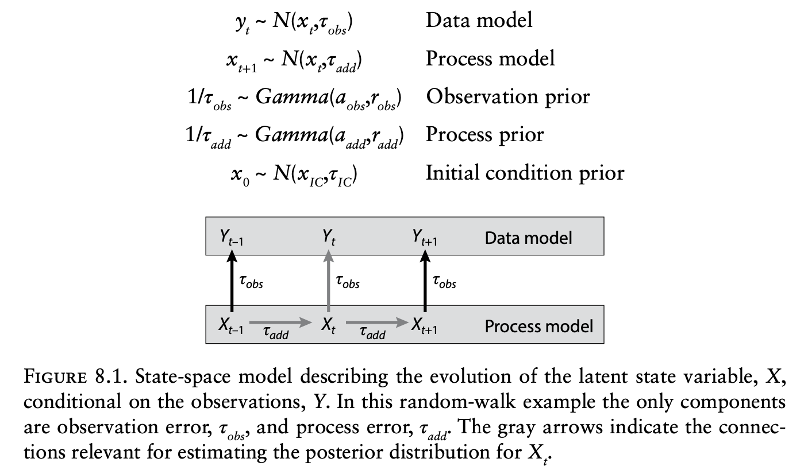
Previous models
Dietz 2017. Ecological forecasting.

Slide 7
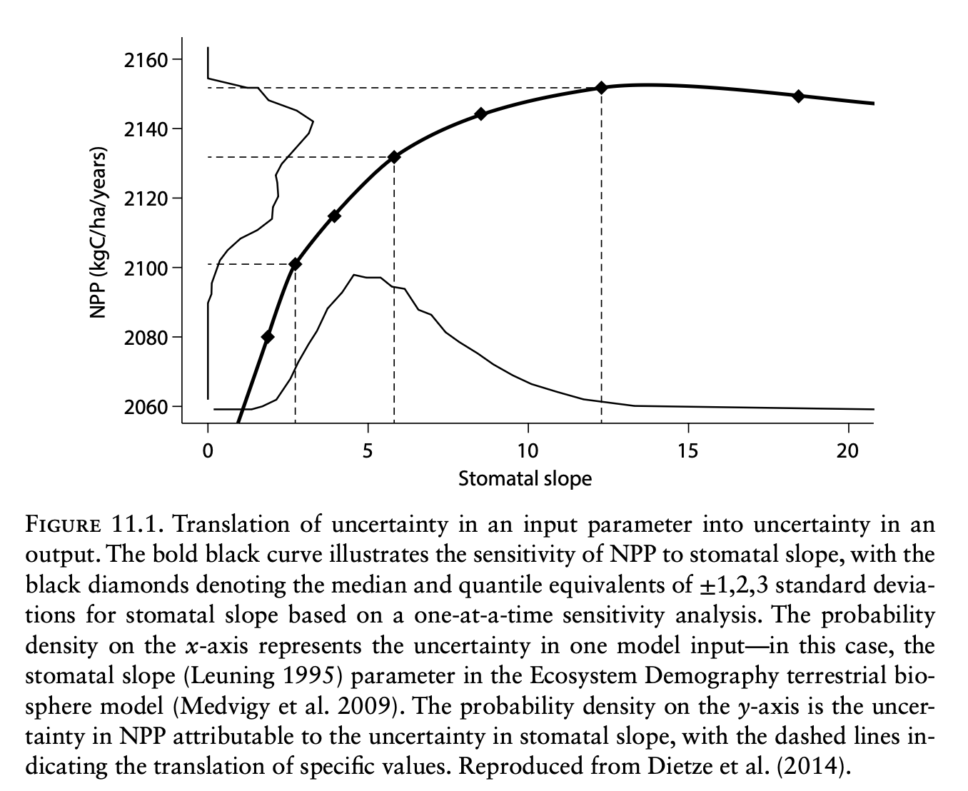
Local sensitivity - OAT
Dietz 2017. Ecological forecasting.

Slide 8
Definitions
Local sensitivity – applies at one location in parameter space.
Global sensitivity – considers all parameter values.
One-at-a-time sensitivity (OAT) – all parameters equal to their mean and vary one;
Dietz 2017. Ecological forecasting.

Slide 9
Global sensitivity - Monte Carlo
Brute force – computationally demanding
Sample from parameter space and run model. Uniform is common, but not necessarily recommended (?)
Never truly global - sensitive to the domain chosen. Recommends setting the range to 95% or 99% CI.
Estimate the sensitivity by fitting a multiple regression to the output as a function of the randomly sampled inputs
Dietz 2017. Ecological forecasting.

Slide 10
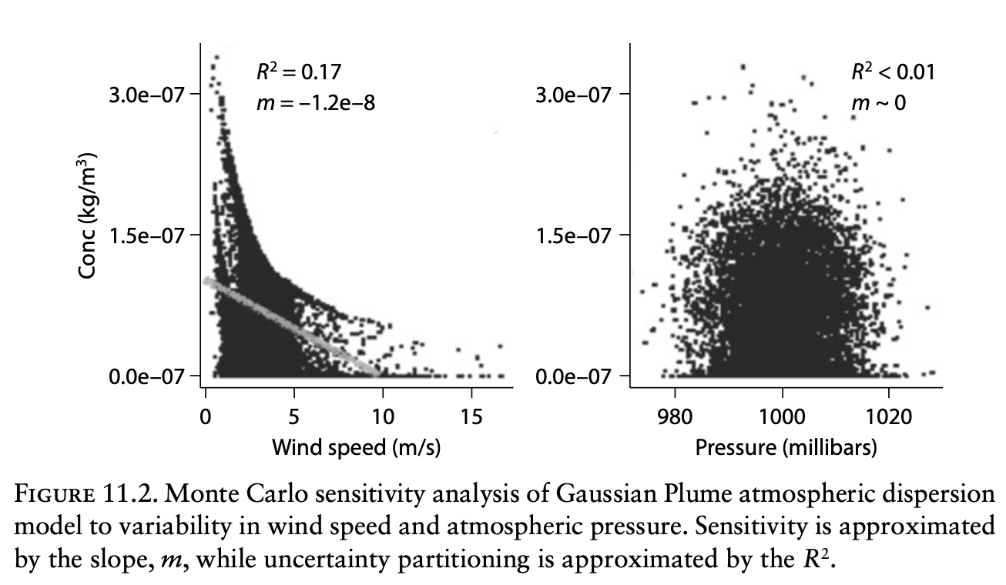
Global sensitivity - Monte Carlo
Dietz 2017. Ecological forecasting.

Slide 11
Global sensitivity – other approaches
Entire books on this topic, i.e., Saltelli et al. 2008
For computational efficiency:
Halton sequence
Sobol’s LP sequence
Latin Hypercube Sampling
Use an emulator (Box 11.1)
Dietz 2017. Ecological forecasting.

Slide 12
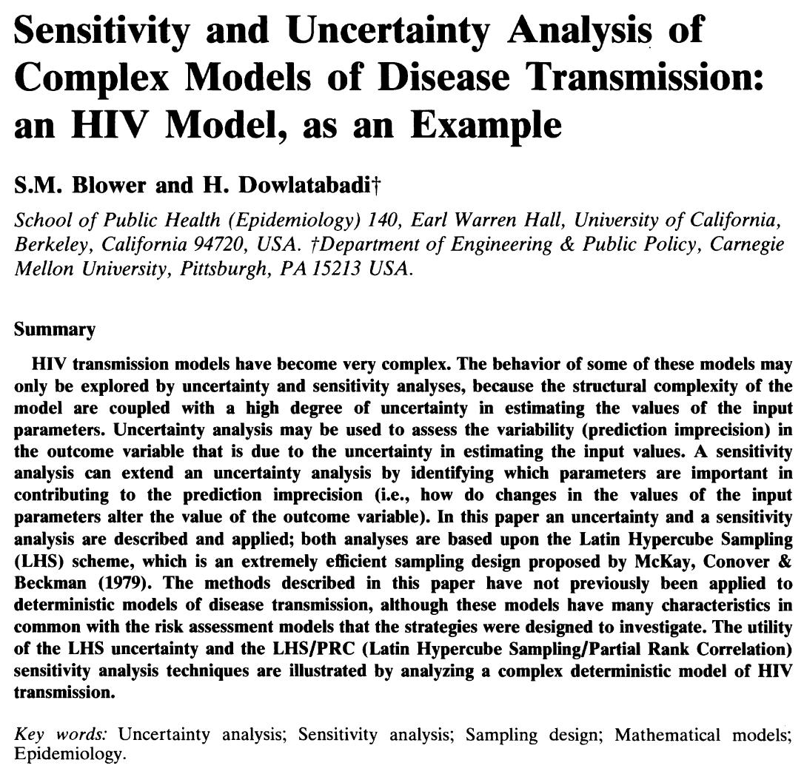
Latin Hypercube Sampling

Slide 13
Latin Hypercube Sampling
Define the probability distribution functions for the K parameters and the state variable initial values
Calculate the number of simulations
Divide the range of each of the K parameters into N equi-probable intervals
Create the LHS table
Sample the values of the input parameters and perform the N simulations
Analysis of the outcomes: uncertainty analysis
Analysis of the outcomes: sensitivity analysis

Slide 14
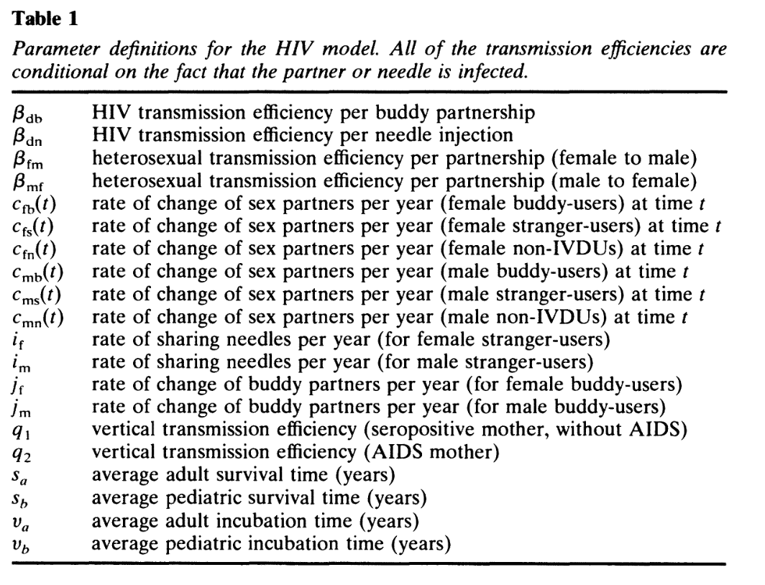
LHS – HIV model
Blower & Dowlatabadi (1994)

Slide 15
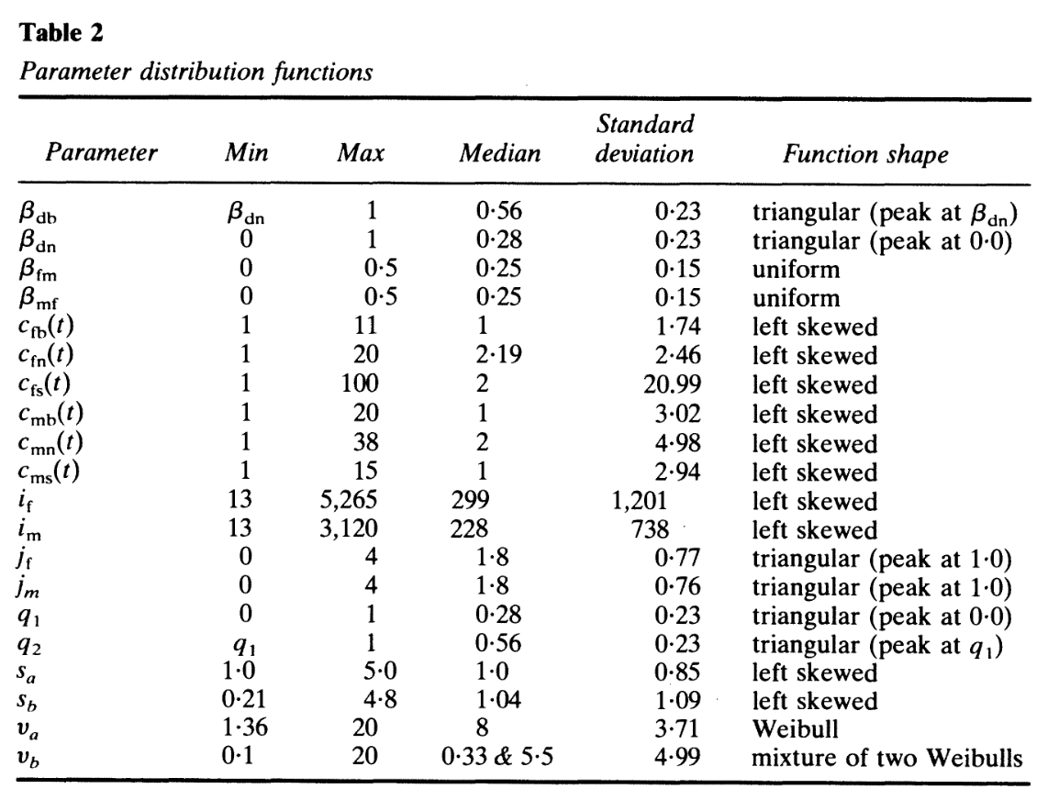
1. Define the PDFs for the parameters
Blower & Dowlatabadi (1994)

Slide 16
2. Calculate the number of simulations
Necessary N > (4/3)K
When N is large, better ability to detect effects in statistical analysis (PRCC)
Blower & Dowlatabadi (1994): K = 20 + 7, N = 100
Blower & Dowlatabadi (1994)

Slide 17
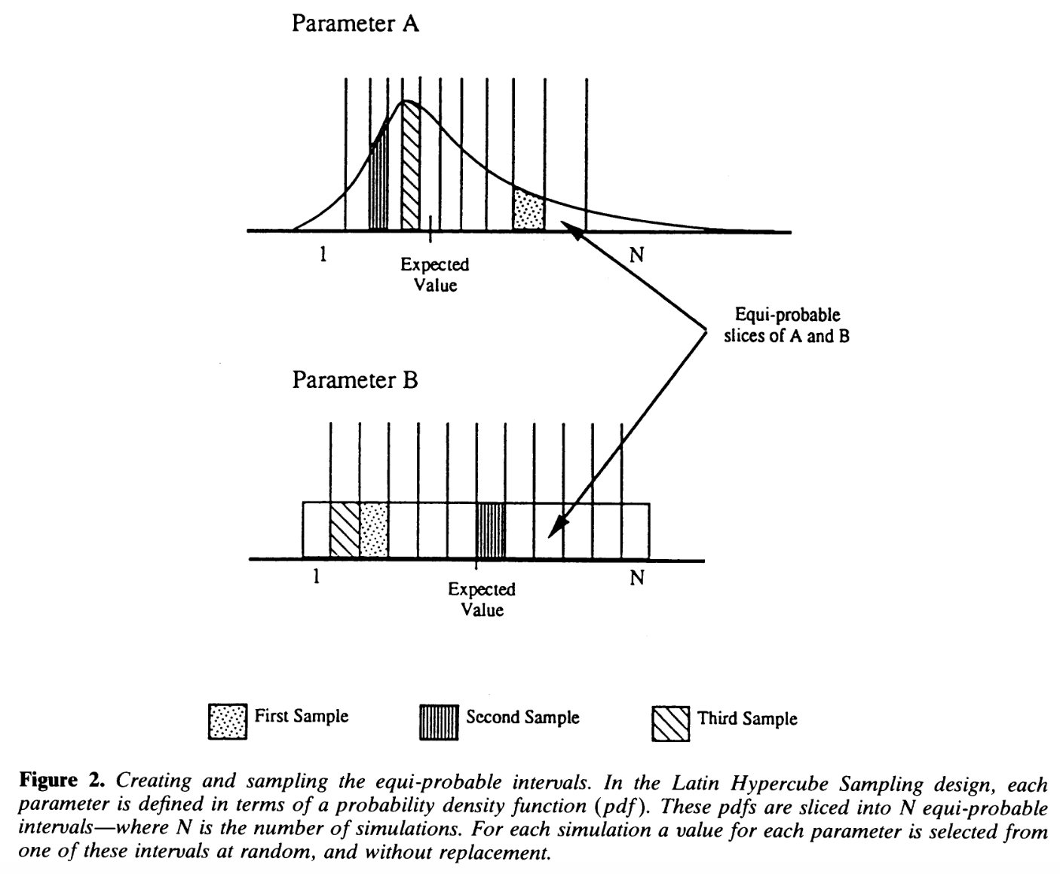
3. Divide each parameter range into N equi-probable regions
Blower & Dowlatabadi (1994)

Slide 18
4. Create the LHS table
N x K table, random sampling of PDF indices, i, without replacement
 | β_{db} | β_{dn} | β_{fm} | … | male-strangers t=0
1 | i=73 | i=22 | i=10 | … | i=12
2 | i=22 | i=4 | i=22 | … | i=17
3 | i=1 | i=77 | i=65 | … | i=91
… | … | … | … | … | …
N | determined | determined | determined | determined | determined

Slide 19
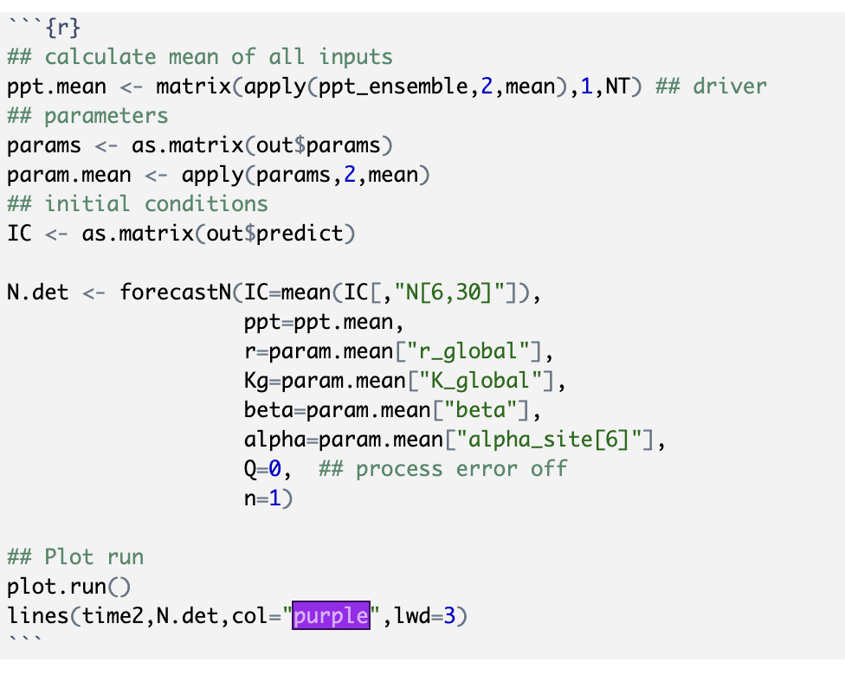
5. Run the N simulations

Slide 20
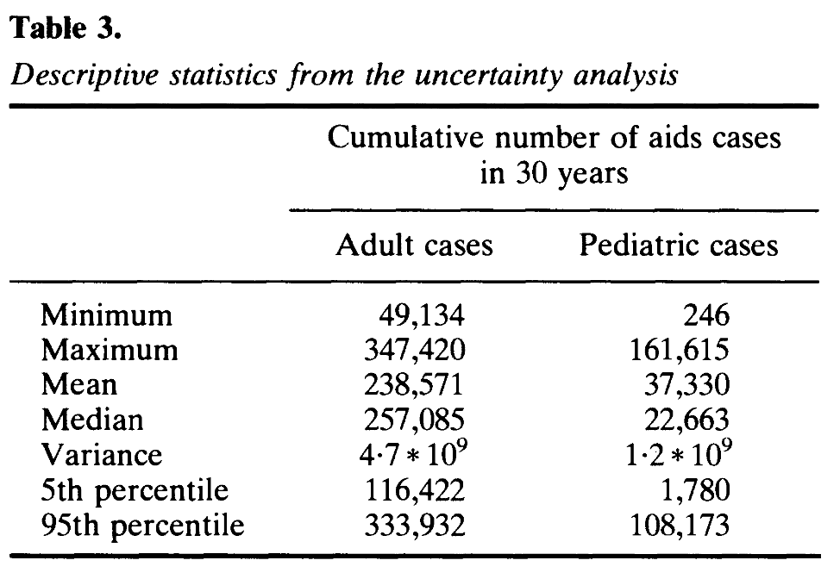
6. Outcomes: Uncertainty analysis
Prediction precision is low

Slide 21
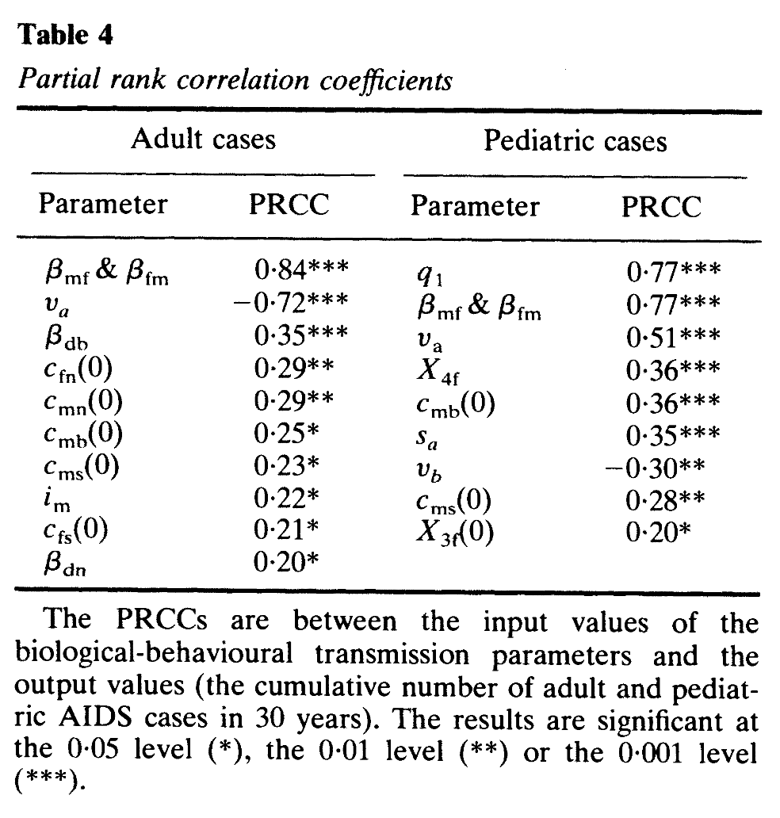
7. Outcomes: sensitivity analysis
PRCC determines statistical relationship between each input variable and each outcome variable while keeping all other inputs at their mean value
Assumes monotonicity between input and outcome – assess with scatter plot
Sign of the PRCC indicates the qualitative effect
Magnitude of the PRCC importance of uncertainty of the input quantity on the imprecision of the output variable

Slide 22
HIV model conclusion
The two heterosexual transmission efficiencies and the average adult incubation period) are the most critical in affecting the prediction precision of the future number of adult AIDS cases.
The estimation uncertainty of these three parameters are also critical in contributing to the prediction precision of the number of pediatric AIDS cases, however in this case the vertical transmission efficiency is also of great importance (see Table 4).
Note: HIV model has stable dynamics; monotonicity assumption may not be satisfied for models with chaos, i.e. measles

Slide 23
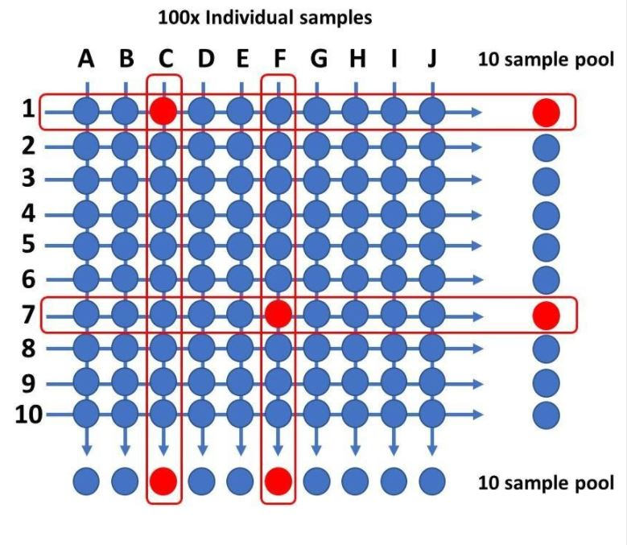
Global sensitivity – sampling methods
Group sampling
Super-saturated design
Pooled testing for SARS-CoV-2 could provide the solution to UK’s testing strategy

Slide 24
Key concepts - sensitivity
Sensitivity analysis assess how a change in an input translates into a change in output
The curse of dimensionality: parameter space increases exponentially with the number of parameters
The range of parameters explored should be tied to the probability distribution of the inputs
Monte Carlo is a brute force approach, there are other more computationally efficient sampling strategies
Dietz 2017. Ecological forecasting.

Slide 25
Ch 11. Propagating analyzing, and reducing uncertainty
Amy Hurford
Memorial University

Slide 26
Uncertainty propagation
A forecast without a statement of uncertainty is of limited value
Uncertainty propagation refers to inputting the uncertainty into the model to determine the uncertainty in the output
Approach: analytical or numerical
Output: full probability distribution or statistical moments
Dietz 2017. Ecological forecasting.

Slide 27
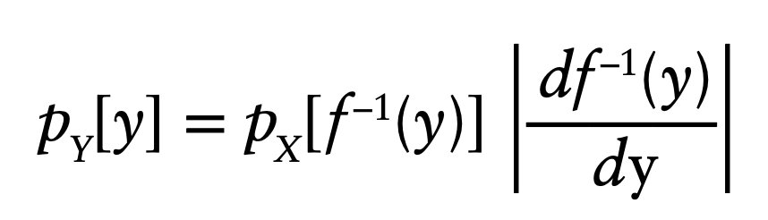
Variable transformation
Approach: Analytical; Output: full probability density
Not possible except in simplest of cases
Dietz 2017. Ecological forecasting.

Slide 28
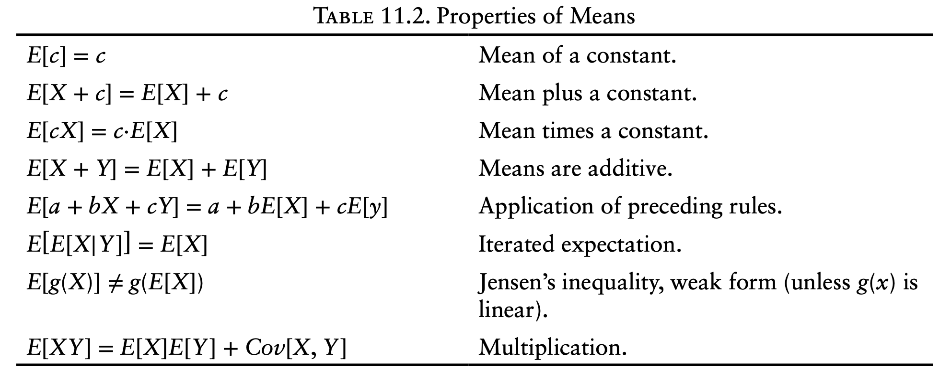
Analytical moments
Approach: Analytical; Output: Statistical moments
Dietz 2017. Ecological forecasting.

Slide 29
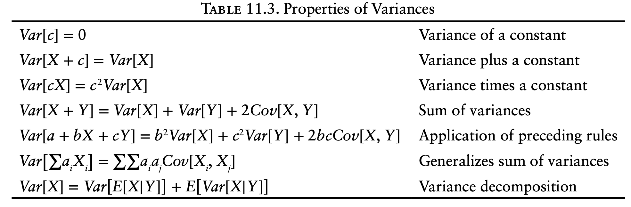
Analytical moments
Approach: Analytical; Output: Statistical moments
Dietz 2017. Ecological forecasting.

Slide 30
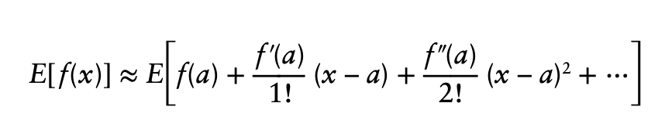
Analytical moments – Taylor series
Approach: Analytical; Output: Statistical moments
Dietz 2017. Ecological forecasting.

Slide 31
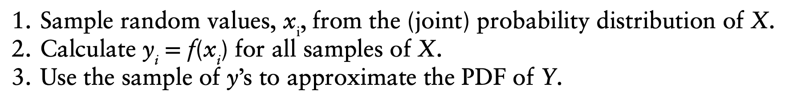
Monte Carlo (distribution)
Approach: Numerical, Output: full probability density
Dietz 2017. Ecological forecasting.

Slide 32
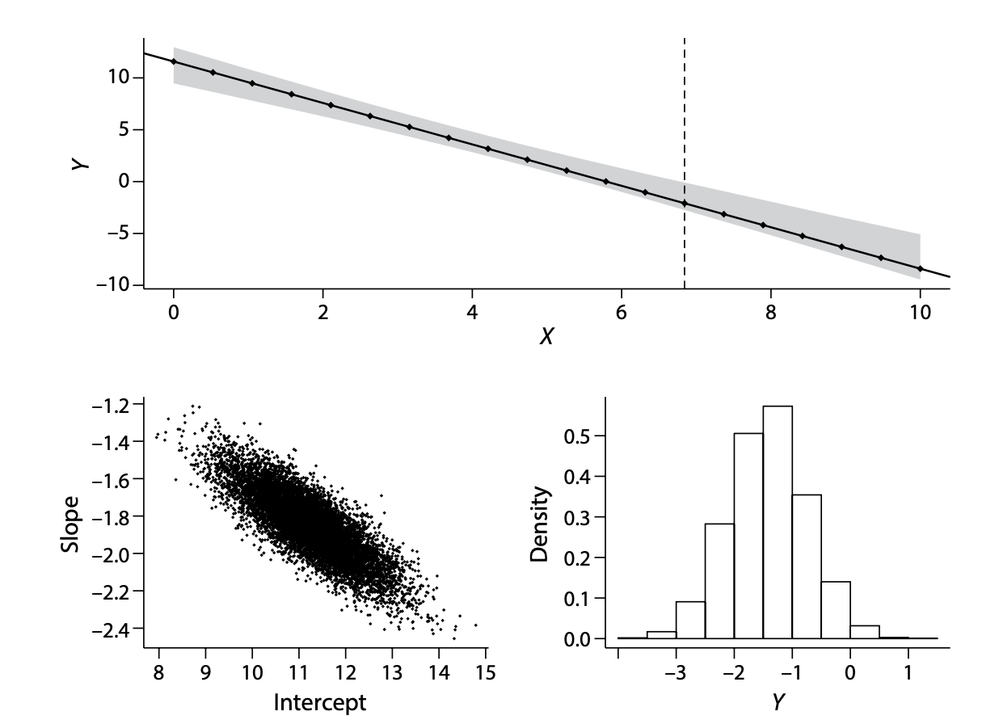
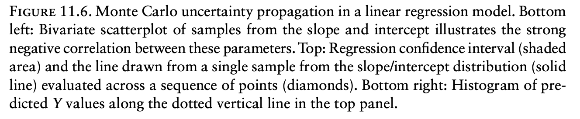
Monte Carlo (distribution)
Approach: Numerical, Output: full probability density
Dietz 2017. Ecological forecasting.

Slide 33
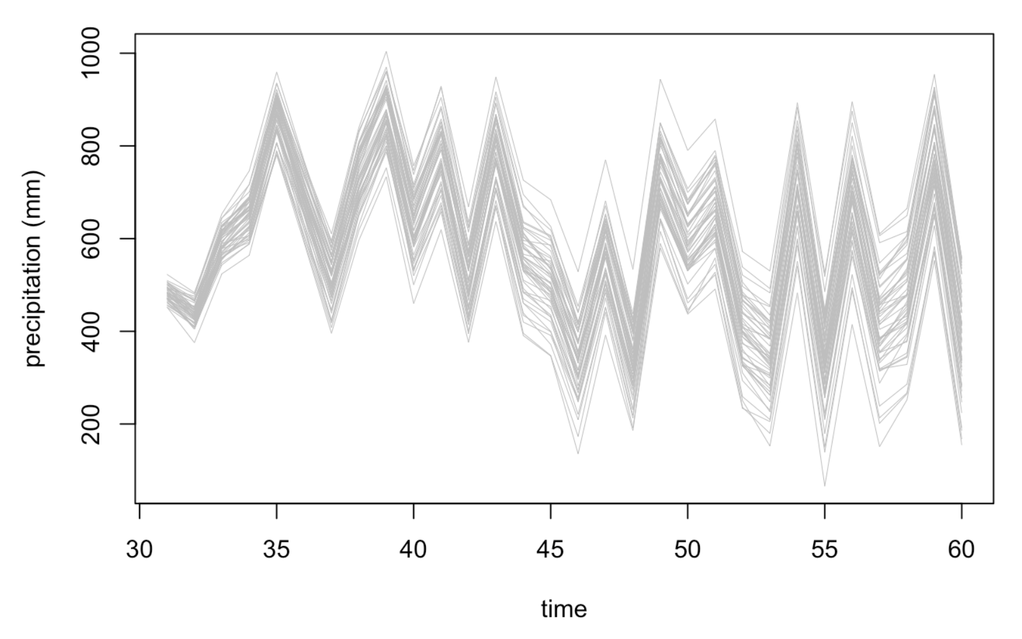
Ensemble (Stats)
Approach: Numerical, Output: full probability density
Closely related to Monte Carlo, but smaller sample size: 10-100
Dietz 2017. Ecological forecasting.

Slide 34
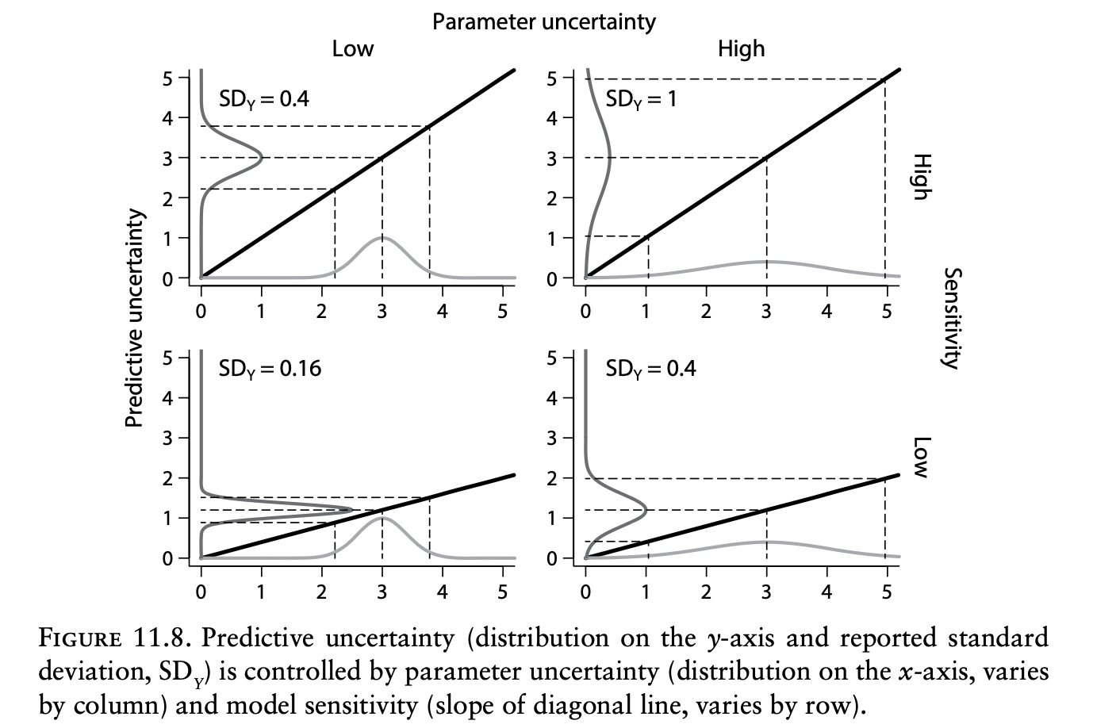
Uncertainty analysis
Attribute the uncertainty in some output, to different inputs
Dietz 2017. Ecological forecasting.

Slide 35
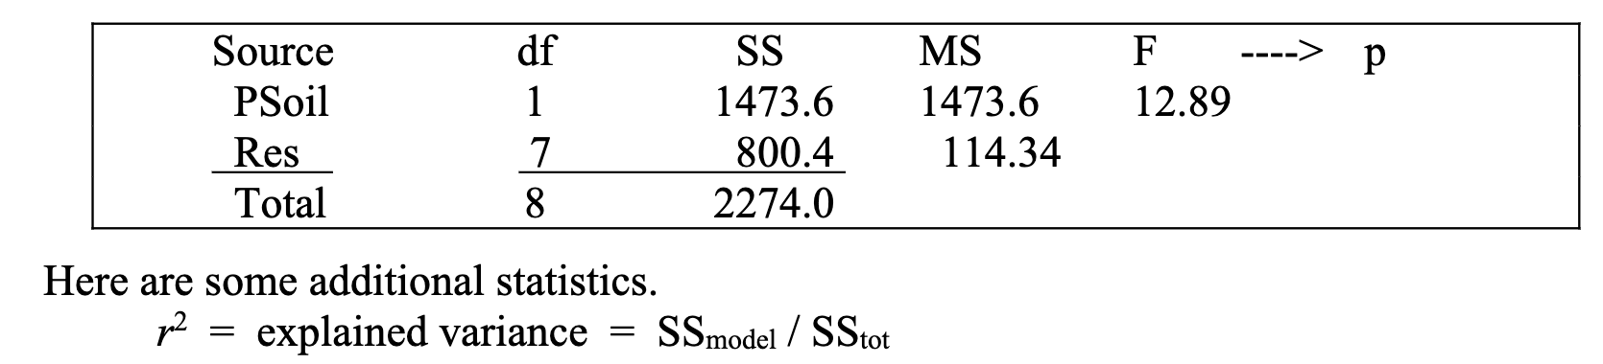
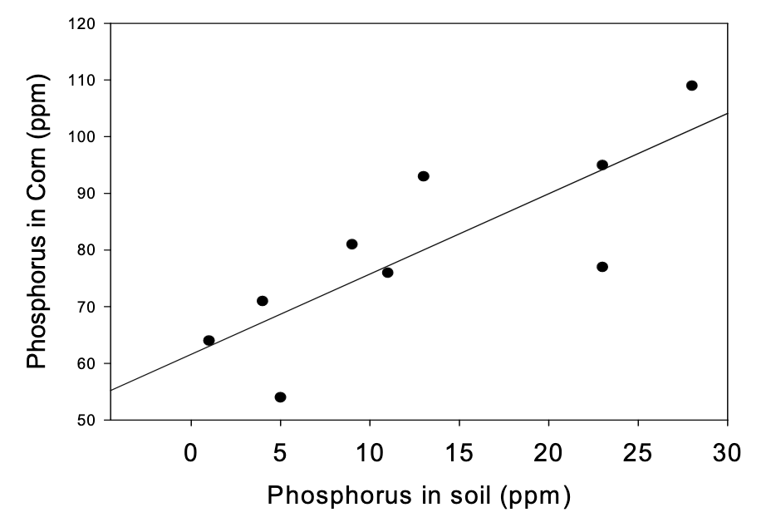
Partitioning uncertainty
General linear models (R² = 1-SS/SS_{Total})
By Dave Schneider

Slide 36
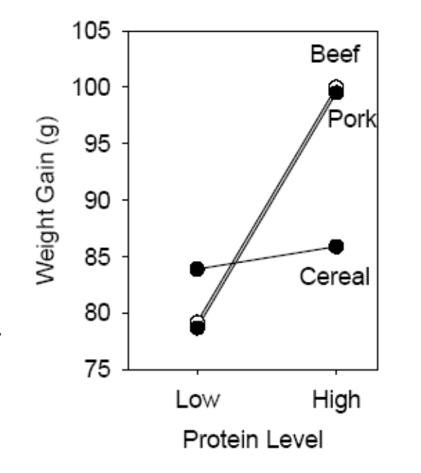
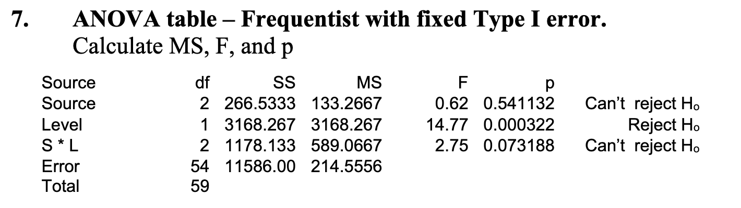
Partitioning uncertainty
General linear models (R² = 1-SS/SS_{Total})
By Dave Schneider

Slide 37
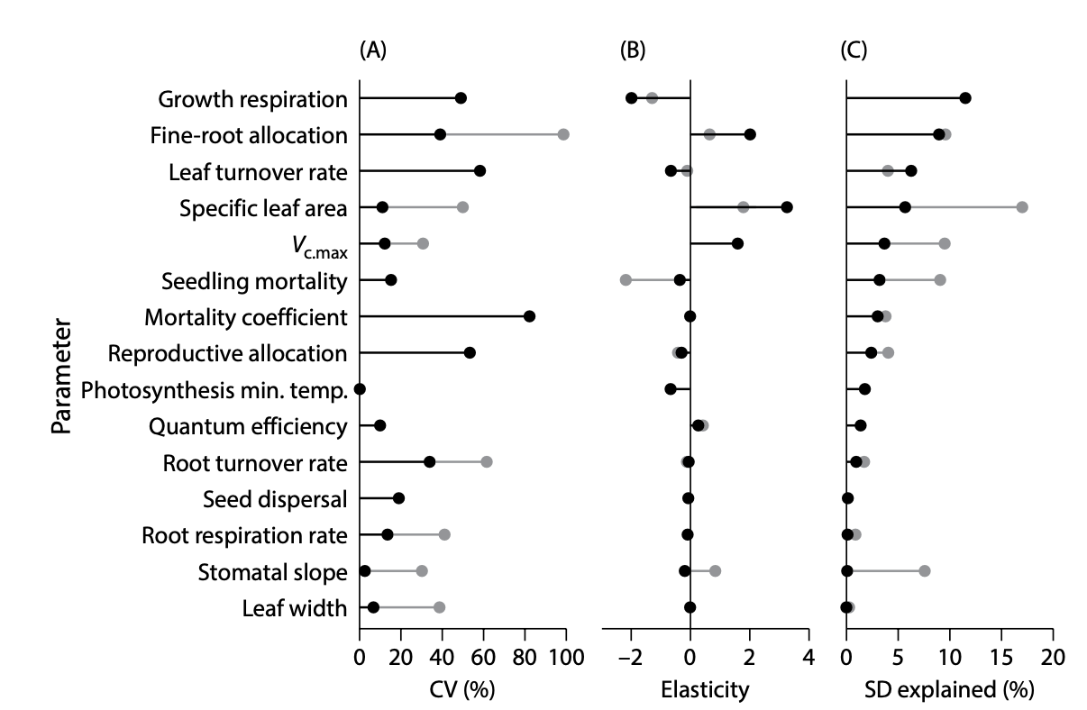
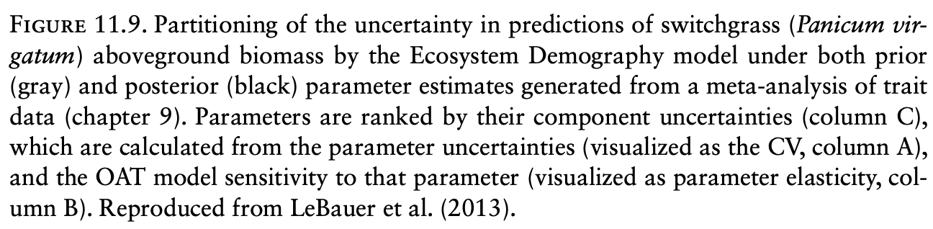
Partitioning uncertainty
Dietz 2017. Ecological forecasting.

Slide 38
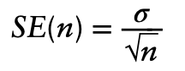
Tools for model-data feedback
How much effort should be invested in estimating particular model inputs, given limited resources?
Standard error in a parameter estimate decreases with sample size
A general approach to power analysis is Monte Carlo simulation of different sampling schemes or sizes
Dietz 2017. Ecological forecasting.

Slide 39
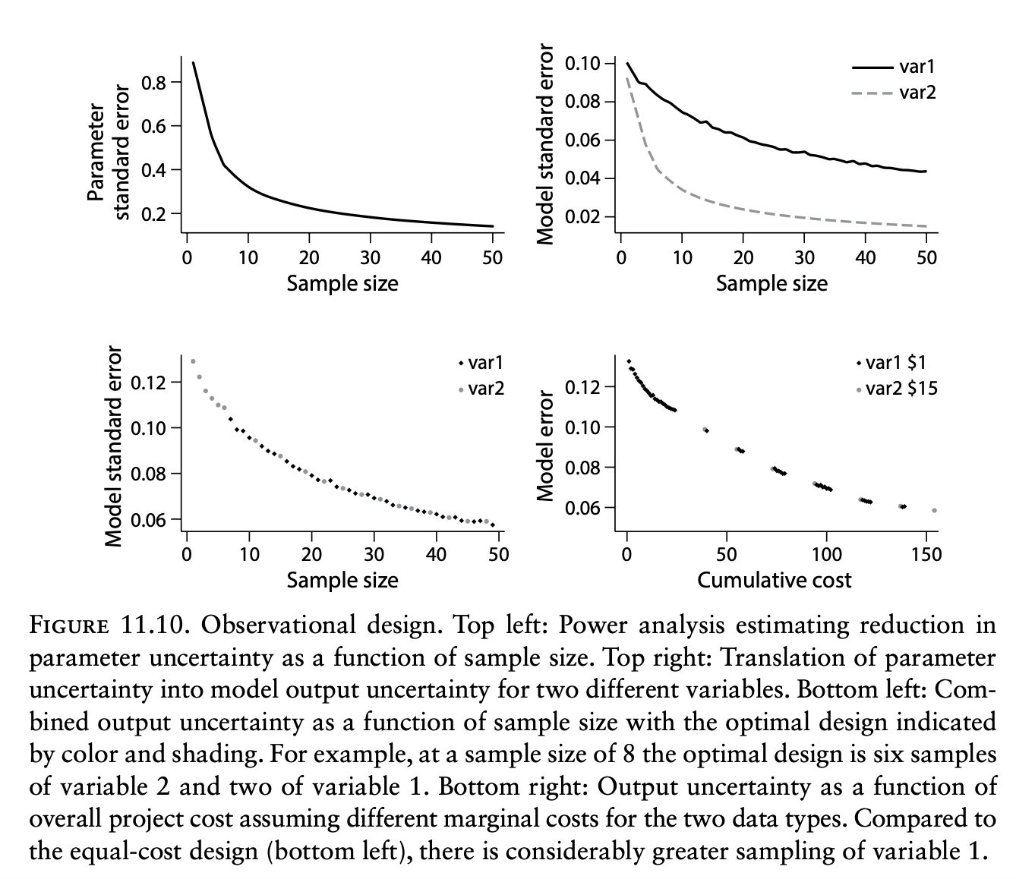
Power analysis
Observational design
Dietz 2017. Ecological forecasting.

Slide 40
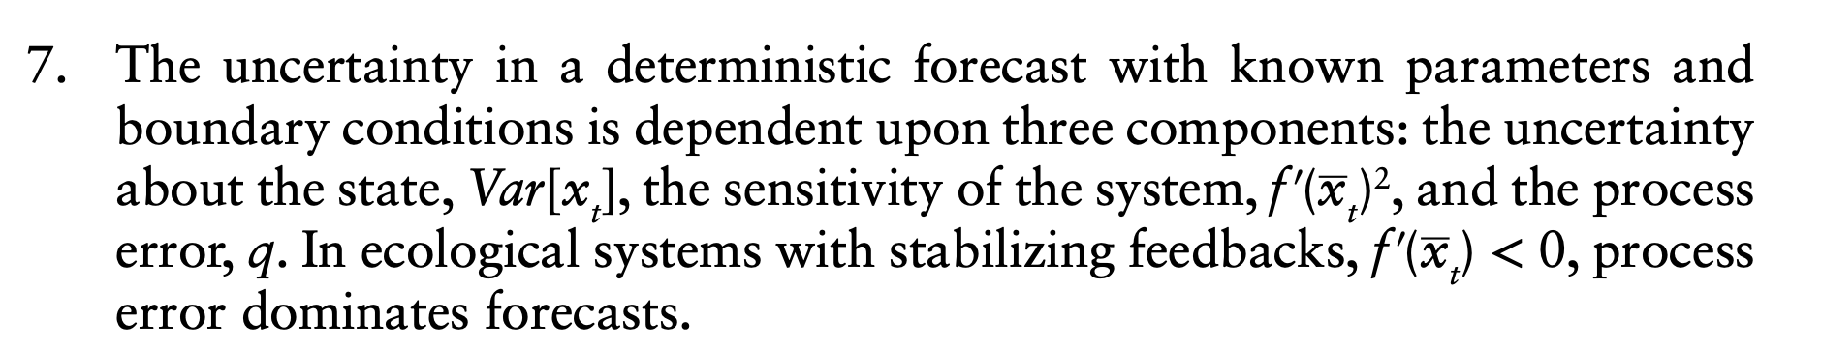
Key concepts
4. Uncertainty propagation is the process of translating uncertainty in our model inputs into uncertainty in model outputs
9. A parameter can be important either because it is sensitive, or because it’s unknown.
Dietz 2017. Ecological forecasting.

Slide 41
Key concepts
9. A parameter can be important either because it is sensitive, or because it’s unknown.
10. More precise answers require more computation, while approximations require stronger assumptions.
Dietz 2017. Ecological forecasting.

